Slide 1

Intro to Git
ITSC 3155 092 – Spring 2022

Slide 2

When learning a new technology, always ask: What problem is it solving?

Slide 3
What’s the problem?
In real life, applications evolve over time
Therefore, code changes over time, but we sometimes need to “rollback” to old versions
Developers needed a solution to track changes in their code over time
Problem gets more complex when you add more developers working on the same app at the same time (different, simultaneous versions need to be merged)

Slide 4
Enter: Version Control Systems
Track and manage changes in our code
We can make snapshots of our code changes that can act as “save points”
Allow us to rewind time to “check out” old versions of our code
Multiple developers can have multiple versions at the same time and merge them together

Slide 5
So, what is git?
By far the most popular version control system
Created in 2005 by Linus Torvalds (creator of Linux)
Performant compared to other VCSs
Distributed – every developer’s computer is its own repository

Slide 6


Using Git
Initialize a git repository in your project folder with git init
Write code as normal until we get to where we want to make a “commit” (make a save point)
“Stage” the files we want to commit with git add <filename> or, to add everything, git add .
“Commit” the staged files with git commit –m “Commit message”
Repeat
Run git status to see what is staged
Eventually, push our local repository to a remote repository (online) so other developers can check out our changes

Slide 7
Unique “hash” to identify commit
Make more changes
bdc1d1d
git add
ed4f92c
git add
git commit
git commit
Working Directory
(Current file changes)
Staged files (ready to be committed)
Commit #1 (file changes are saved as a “save point”)
Working Directory
(Current file changes)
Staged files (ready to be committed)
Commit #2 (file changes are saved as a “save point”)

Slide 8
“Change #1”
“Change #3”
“Change #5”
bdc1d1d
ed4f92c
0c4b62b
db84e1b
72a182d
“Change #2”
“Change #4”

Slide 9
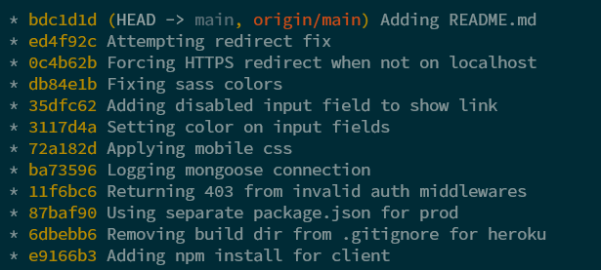

Slide 10

Let’s do it for real

Slide 11

Remotes
So far, we have been committing to our local repository (repository on our own computer)
We want to make our code available to other developers
On our own team in a private repository
To the public as open-source software in a public repository
To recruiters and hiring managers at companies we apply to
To our instructor and TAs so they can grade our work 👀
There are many popular, free git repositories hosting services– we will use GitHub

Slide 12
Setting up with the remote – Done Once at the beginning of the project
Cloning an existing repository from the remote to your local repository
If the code exists in the remote but not your local computer
git clone <repo-url>
The project folder now exists in your current folder
Push an existing local repository to a remote from our local repository
If you start the project on your own computer and need initialize the remote repository
Create an empty repository in GitHub (or another remote git repository service)
In an existing, local repository, run: git remote add origin <url>
Then run: git branch –m main to change your current branch name to match GitHub (more info on this later)
Then, run: git push –u origin main
Refresh the GitHub repository page and your code should be there

Slide 13
Syncing with the remote
You can get new commits from the remote with git pull
You can push new commits with git push
Note that we used git push –u origin main in the last slide, you only need to do that once with a new branch (more on branches later)

Slide 14
Remote Repository (GitHub)
bdc1d1d
ed4f92c
0c4b62b
db84e1b
72a182d
git pull
git push
bdc1d1d
ed4f92c
0c4b62b
db84e1b
72a182d
Local Repository (Our Computer)
git commit
git commit

Slide 15
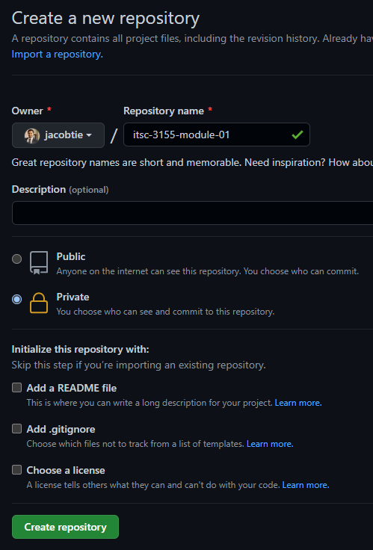
GitHub
Sign up for an account at github.com
Do NOT use your @uncc.edu email or you will lose all your projects after you graduate
Create a new, private repository with the other settings default
Only make your repositories public after the due date to discourage academic dishonesty

Slide 16
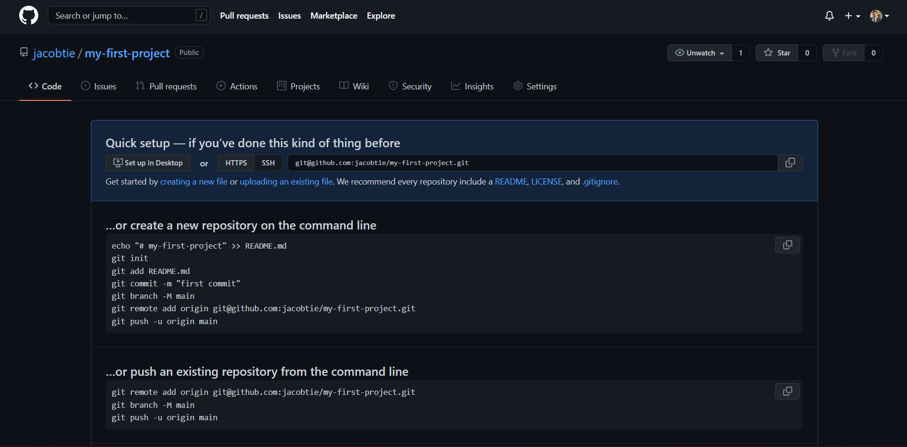

Slide 17

After pushing our local repository…

Slide 18
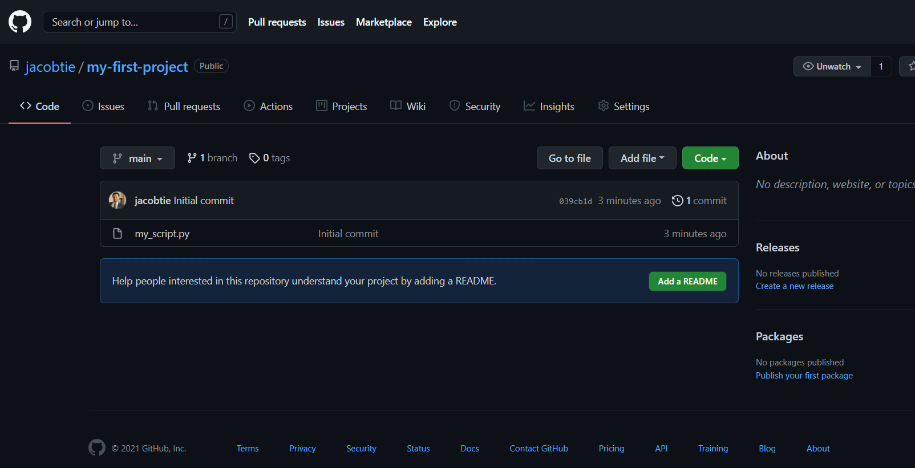

Slide 19

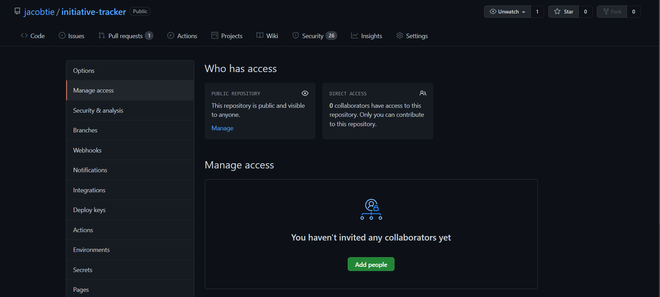
Add my and the TAs’ Usernames to each repository you submit

Slide 20
Our GitHub Usernames
Jacob Krevat – jacobtie
Hunter Kepley – hunterkepley
Michael Pearce - mpearce9

Slide 21
Configuring Git Locally
Assuming you already have git installed, run the following two commands with your info (do include the double quotes, do not include the angle brackets)
git config --global user.name "<your_name_here>"
git config --global user.email "<your_email@email.com>"

